Slide 1

DIGITAL DESIGN AND COMPUTER ORGANIZATION LABORATORY
UE19CS206
(0-0-2-1-1)
Prof Deepti C
Computer Science and Engineering

Slide 2

DDCO Lab: Tools / Languages
Icarus Verilog Simulator
GTKWave Waveform Viewer
Department of Computer Science and Engineering

Slide 3

DIGITAL DESIGN AND COMPUTER ORGANISATION LABORATORY
iVerilog Installation
What is Icarus Verilog?
Icarus Verilog is a Verilog simulation and synthesis tool.
Icarus Verilog is available for Linux, Windows and Mac OS X. It is released under the GNU General Public License.
It operates as a compiler, compiling source code written in Verilog (IEEE-1364) into a target format.
Department of Computer Science and Engineering

Slide 4
DIGITAL DESIGN AND COMPUTER ORGANISATION LABORATORY
iVerilog Installation
Installation on Ubuntu (tested on 13.10)
sudo apt-get update
sudo apt-get install iverilog
sudo apt-get install gtkwave
Installation on Windows
Download and run the iverilog-0.9.7_setup.exe installer from http://bleyer.org/icarus.
Accept all of the default choices as you click through the installation.
Make sure the installation was successful by opening up the command prompt (hit Windows+R and run cmd) and entering the command iverilog
Department of Computer Science and Engineering

Slide 5
DIGITAL DESIGN AND COMPUTER ORGANISATION LABORATORY
iVerilog Installation
What is GTKWave?
GTKWave is an open-source waveform viewer that displays VCD (and other) files graphically .
GTKWave is a fully featured GTK+ based waveform viewer, which is used to view the simulated output of the Verilog code.
Department of Computer Science and Engineering

Slide 6
DIGITAL DESIGN AND COMPUTER ORGANISATION LABORATORY
Introduction to Verilog
HDL Overview
Hardware description languages (HDL) offer a way to design circuits using text-based descriptions
HDL describes hardware using keywords and expressions.
Logic expressions, truth tables, functions, logic gates
Two primary hardware description languages
VHDL
Verilog
Department of Computer Science and Engineering

Slide 7
DIGITAL DESIGN AND COMPUTER ORGANISATION LABORATORY
Introduction to Verilog
Popularity of Verilog
General-purpose
Easy to learn, easy to use
Similar in syntax to C
Supported by most popular logic synthesis tools.
There are four levels of abstraction in Verilog.
1. Circuit Level
2. Gate Level
3. Data Flow Level
4. Behavioural Level
In Verilog HDL a module can be defined using various levels of abstraction.
Department of Computer Science and Engineering

Slide 8
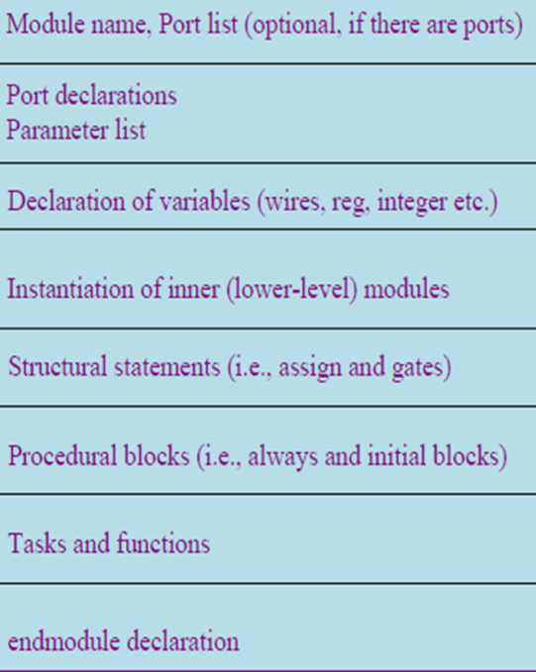
DIGITAL DESIGN AND COMPUTER ORGANISATION LABORATORY
Verilog Language Basics
Module Declaration
General definition module module_name circuit_name ( port_list ); port declarations; … variable declaration; … description of behavior endmodule
Department of Computer Science and Engineering

Slide 9
DIGITAL DESIGN AND COMPUTER ORGANISATION LABORATORY
Verilog Language Basics
Module Definition
Module are the building blocks of Verilog designs
Describes the functionality of the design
States the input and output ports
module followed by circuit name and port list
Each port is either an input or output
Always terminates with endmodule
All code are contained in modules
Modules cannot be contained in another module
Can invoke other modules
Department of Computer Science and Engineering

Slide 10

DIGITAL DESIGN AND COMPUTER ORGANISATION LABORATORY
Verilog Language Basics-Logic Gates
/* A simple AND gate File: and2.v */
module andgate (a, b, y);
input a, b;
output y;
assign y = a & b;
endmodule
=y
a | b | y= a.b
0 | 0 | 0
0 | 1 | 0
1 | 0 | 0
1 | 1 | 1
Department of Computer Science and Engineering

Slide 11
DIGITAL DESIGN AND COMPUTER ORGANISATION LABORATORY
Verilog Language Basics-Logic Gates
/* testbench for AND gate File: and2_tb.v */ module andgate_tb; wire t_y; reg t_a, t_b; andgate my_gate( .a(t_a), .b(t_b), y(t_y) ); initial begin
$monitor(t_a, t_b, t_y); t_a = 1'b0; t_b = 1'b0; #5 t_a = 1'b0; t_b = 1'b1; #5 t_a = 1'b1; t_b = 1'b0; #5 t_a = 1'b1; t_b = 1'b1;
end endmodule
Department of Computer Science and Engineering

Slide 12
DIGITAL DESIGN AND COMPUTER ORGANISATION LABORATORY
Verilog Language Basics
Steps for execution
iverilog –o test1 and2.v and_tb.v
vvp test1
gtkwave and2_test.vcd
Department of Computer Science and Engineering

Slide 13
DIGITAL DESIGN AND COMPUTER ORGANISATION LABORATORY
Verilog Language Basics
Symbols:
AND ----- &
OR ------ |
Not----- !
XOR---- ^
Department of Computer Science and Engineering

Slide 14

DIGITAL DESIGN AND COMPUTER ORGANISATION LABORATORY
Verilog Program-Simple Circuit
module simple_circuit
(A, B, C, D, E);
output D, E;
input A, B, C;
wire w1;
and G1 (A, B,w1); // Optional gate instance name
not G2 (C,E);
or G3 ( w1, E,D);
endmodule
Department of Computer Science and Engineering

Slide 15
DIGITAL DESIGN AND COMPUTER ORGANISATION LABORATORY
Verilog Program-Simple Circuit
// Test bench for Simple_Circuit_prop_delay
module tb_simple_circuit;
wire D, E;
reg A, B, C;
simple_circuit M1 (A, B, C, D, E); // Instance name required
initial
begin
$dumpfile(“simple.vcd");
$dumpvars(1,tb_simple_circuit);
A = 1'b0; B = 1'b0; C = 1'b0;
#20
A = 1'b0; B = 1'b0; C = 1'b1;
#20
A = 1'b0; B = 1'b1; C = 1'b0;
#20
Department of Computer Science and Engineering

Slide 16
DIGITAL DESIGN AND COMPUTER ORGANISATION LABORATORY
Verilog Program-Simple Circuit
A = 1'b0; B = 1'b1; C = 1'b1;
#20
A = 1'b1; B = 1'b0; C = 1'b0;
#20
A = 1'b1; B = 1'b0; C = 1'b1;
#20
A = 1'b1; B = 1'b1; C = 1'b0;
#20
A = 1'b1; B = 1'b1; C = 1'b1;
#20
end
initial
#200
$finish;
endmodule

Slide 17
DIGITAL DESIGN AND COMPUTER ORGANISATION LABORATORY
Verilog Program-Simple Circuit
Compiling your Verilog program
You need to compile your Verilog program before you can
simulate it.
Open up a DOS prompt (run cmd.exe from the Start menu)
and type the following, hitting enter after each line:
C: cd verilog\bin\week1\simple
verilog -o simple simple_circuit.v simple_circuit_tb.v
If the compilation went OK, you won't see any output.
What this does is create a file called simple.vvp that we can
feed to the simulator.
"-o" flag tells the compiler where to place the compiled result.
Department of Computer Science and Engineering

Slide 18
DIGITAL DESIGN AND COMPUTER ORGANISATION LABORATORY
Verilog Program-Simple Circuit
Next, execute the compiled program
Running the simulation
To run the simulation, type
vvp simple and hit enter.
You should see output something like:
VCD info: dumpfile simple.vcd opened for output.
A is 1010, B is 0011. A is 1100, B is 0101.
Viewing the output
You can use the GTKWave program to view the output.
At the terminal type gtkwave simple.vcd to view the results of your simulation.
Department of Computer Science and Engineering

Slide 19

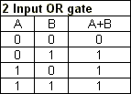

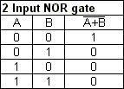
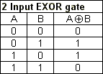

DIGITAL DESIGN AND COMPUTER ORGANISATION LABORATORY
LAB Assignment 1
Verilog Language Basics-Logic Gates
Department of Computer Science and Engineering

Slide 20



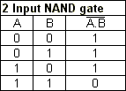
DIGITAL DESIGN AND COMPUTER ORGANISATION LABORATORY
Verilog Language Basics-Logic Gates
Lab Assignment 1-Logic Gates
Department of Computer Science and Engineering

Slide 21
DIGITAL DESIGN AND COMPUTER ORGANISATION LABORATORY
Verilog Language Basics-Logic Gates
Lab Assignment 1-Simple Circuits
CIRCUIT 1
CIRCUIT 2

Slide 22
THANK YOU
Deepti C
Department of Computer Science and Engineering
deeptic@pes.edu

